Slide 1
Smart Integrated Tile (S.I.T.)
Sam, Ivy, Tony

Slide 2
100 Island Challenge
Based at Scripps Institute of Oceanography
Investigating how oceanography, geography, and human activity shape the structure and growth of coral reef communities
Large-area imaging of coral reef regions
Data collection via remote sensors to model oceanographic conditions

Slide 3
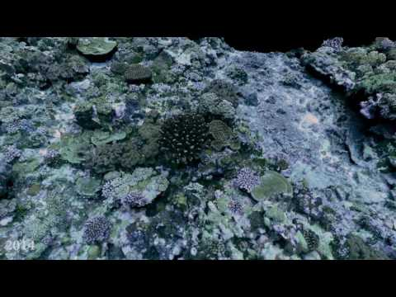

Slide 4
Vision
Create sensor tiles that can be placed on the coral to collect information to be used in the environmental models and datasets
Tiles will be distributed to partners of Scripps collaborating on the project
Current version of the tile does not work
Long-term teams working on the project over the summer
Our Role:
Create multiple, basic versions of the tile
Pass them along to Scripps for field testing, gather their feedback about what works/doesn’t work
Long term team will use feedback as guidance in their work

Slide 5
Core Requirements
Create 2-3 different iterations of a minimum viable product
Waterproof
Depth sensor
Display
MCU
Rechargeable battery
Reprogrammable
Ability to turn on/off
Cheap (less than $100) in order to be widely distributable to collaborators

Slide 6
Iterations
Gather and display depth information
Average depth information over a long period to account for noise in the environment
Detect when picked up by diver and stop collecting depth information (more difficult, possibly a reach goal)

Slide 7
Resources
Eric Lo (technical and logistical)
BZ Zgliczynski at the Scripps Institute (use cases, feedback, ecological)

Slide 8
References
100islandchallenge.org

